Slide 1
ADAPTIVE API RATE LIMITER FOR API ABUSE PREVENTION BASED ON USER BEHAVIOUR ANALYSIS
PROJECT INCHARGE
Ruban Chakravarthy S
M.E. CSE
DEPARTMENT OF Computer Science & Engineering
RVS SOET -DINDIGUL
PRESENTED BY
AMALA NIRMAL FELICX A
RAJA GANAPATHI M
REYASATH A
DEPARTMENT OF Computer Science & Engineering
RVS SOET -DINDIGUL

Slide 2
ABSTRACT
Purpose: Modern APIs face constant threats from automated bots and aggressive users that can overwhelm server resources. This project implements an intelligent middleware system designed to protect backend services by controlling traffic flow in real-time.
Dynamic Throttling: Unlike traditional "fixed" limiters, this system uses an Adaptive Metrics Engine that monitors client behavior.
Proportional Punishment: If a user consistently ignores limits, the system automatically slashes their "refill rate," making it harder for them to make successful requests.
Smart Recovery: Genuine users who stop spamming are gradually granted their original speed back after a "cool-down" period.
High Performance: Powered by Java (Spring Boot) and Redis, the system handles high-concurrency traffic with sub-80ms response times

Slide 3
LITERATURE SURVEY
Core Algorithm
Fixed Window Algorithm : Simple and easy to implement, but vulnerable to sudden traffic spikes at window boundaries.
Leaky Bucket Algorithm : Maintains a constant request flow, though it lacks flexibility for handling legitimate burst traffic.
State Management Approaches :In-memory storage is fast but unreliable in distributed environments, while Redis enables consistent shared state across multiple API servers. (Redis is used in this project).
Adaptive Feedback Mechanism :Traditional static limiters apply fixed rules to all users, whereas adaptive systems dynamically adjust limits based on user behavior.

Slide 4
OBJECTIVE
Primary Goal
  To implement an intelligent API protection layer that dynamically adapts to client behavior, moving beyond the limitations of traditional, static rate limiters.
Technical Objectives
  Adaptive Defense: Develop an engine that automatically punishes aggressive traffic by slashing refill rates while rewarding legitimate users with gradual recovery.
  High-Performance Logic: Utilize a "Lazy Refill" strategy with Redis to ensure sub-millisecond state management and data persistence without high CPU overhead.
  Distributed Consistency: Create a centralized system that enforces synchronized limits across multiple server instances using Docker and Redis.
Key Outcomes
  Behavior Shaping: Discourage bot activity through compounding penalties rather than simple binary blocking.
  Seamless Integration: Provide a production-ready, containerized middleware solution easily adaptable to any Spring Boot microservice architecture.

Slide 5
EXISTING SYSTEM
Static Rate Limiting :Existing systems use fixed request limits (e.g., 5 requests/second) for all users, regardless of behavior patterns.
Binary Decision Model :Requests are either fully allowed or completely blocked, with no intelligent handling for suspicious users.
Manual Configuration Changes : Developers must manually update configurations or code during traffic attacks or unusual API usage.
No Abuse Tracking :After a temporary block expires, the system forgets past aggressive behavior, allowing attackers to continue at full speed.
Lack of Intelligent Protection :Traditional systems treat genuine users and malicious bots equally, offering passive protection without adaptive deterrence mechanism

Slide 6
PROPOSED SYSTEM
Behavior-Based Throttling: The system monitors client activity in real time and dynamically adjusts request limits based on user behavior.
Proportional Penalty Mechanism : Repeated abuse reduces the client’s token refill rate, making continuous spam requests increasingly difficult.
Smart Recovery System : Genuine users who stop excessive requests gradually regain their original request limits after clean usage periods.
Self-Healing Security :Automatically adapts to bot attacks and suspicious traffic without requiring manual configuration changes by developers .
Persistent & Scalable Architecture : Redis and Docker ensure reliable state persistence and continuous protection even after server restarts.

Slide 7
TECHNOLOGIES USED
Core Backend
  Java 17 & Spring Boot 3.5 – High-performance REST API and middleware processing
  Maven – Dependency management and build automation
Data & Storage
  Redis – Real-time in-memory storage for Token Bucket tracking
  AOF Persistence – Prevents data loss after crashes or restarts
Frontend Dashboard
  HTML, CSS, JavaScript & Bootstrap – Responsive dashboard for monitoring requests and rate limits
DevOps & Deployment
  Docker & Docker Compose – Containerized deployment for consistent execution

Slide 8
METHODOLOGY
Request Processing Flow​
Client Identification​: The system identifies each client using the X-API-Key header, with IP address used as a fallback mechanism.
State Retrieval from Redis :Retrieves real-time client data such as token count, refill rate, and request history from Redis for fast synchronization.
Decision-Making Process :
  Allow (HTTP 200): Request proceeds when sufficient tokens are available.
  Block (HTTP 429): Request is denied when tokens are exhausted, returning a JSON error response.
Adaptive State Update :Updates request statistics, rejected counts, and behavioral metrics to support adaptive throttling.
Persistent Data Management :Saves updated client state back to Redis and refreshes the 24-hour TTL to maintain continuous tracking and protection.

Slide 9
TOKEN BUCKET ALGORITHM
Lazy Refill Mechanism :Tokens are recalculated only when a new request arrives, eliminating the need for continuous background timers.
Dynamic Token Refill Logic :The system computes elapsed time since the last request and refills tokens using the adaptive refill formula.
Request Processing Rules :
  Allow: If available tokens ≥ 1, the request is processed and one token is consumed .
  Block: If tokens < 1, the request is rejected with HTTP 429 status.
Burst Traffic Handling: Supports short bursts of requests up to bucket capacity while maintaining controlled long-term traffic flow.

Slide 10
System Architecture
Client
API Gateway
Redis
Cache
Adaptive
Rate Limiter
Traffic
Analyzer
Backend
Services

Slide 11
ADAPTIVE METRICS ENGINE
60-Second Observation Window :The system continuously monitors total requests and rejected requests within a sliding 60-second time frame.
Adaptive Penalty Mechanism :Calculates a reject ratio based on blocked requests and dynamically reduces the client’s token refill rate.
Floor Protection Strategy : Ensures the refill rate never drops below 10% of the base rate, preventing permanent user lockout.
Smart Recovery Process :After 5 consecutive clean windows with zero rejections, the system gradually restores the refill rate by 10% per cycle.
Self-Healing & Behavior Shaping :Discourages bots through progressive throttling while automatically restoring access for legitimate users without manual intervention.

Slide 12
Algorithm Flowchart
Start
API Request
Check Request
History (Redis)
Analyze Traffic
Behavior
Adjust Rate
Limit
Allow / Block
Request

Slide 13
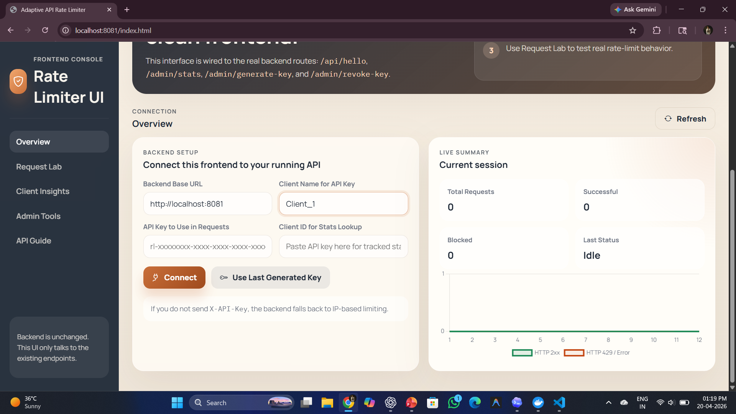
OUTPUT

Slide 14
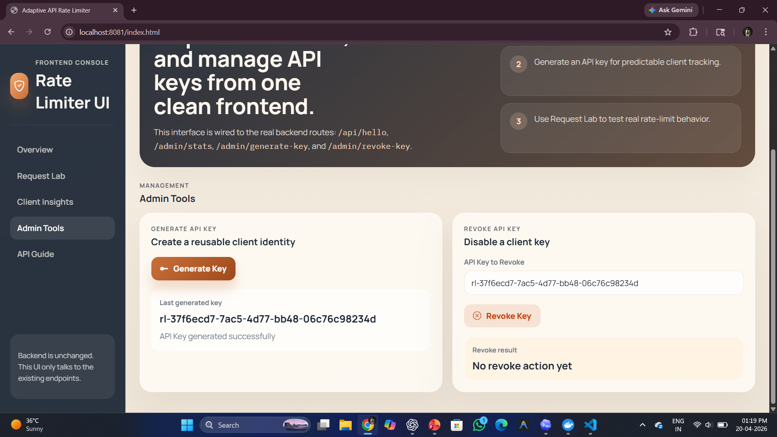

Slide 15
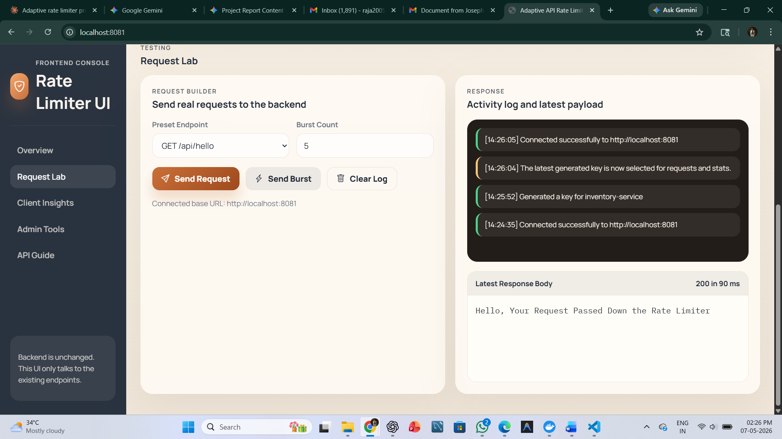

Slide 16
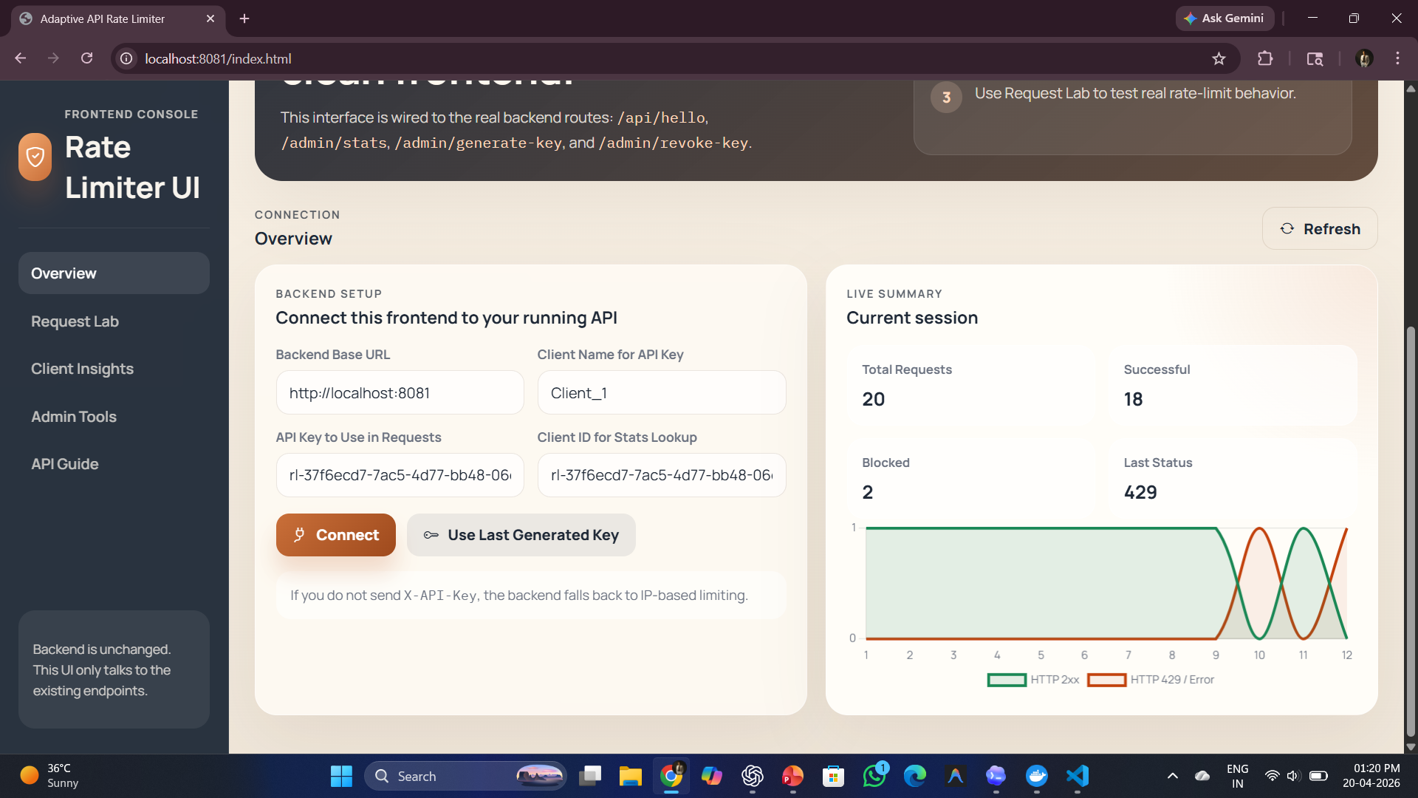

Slide 17
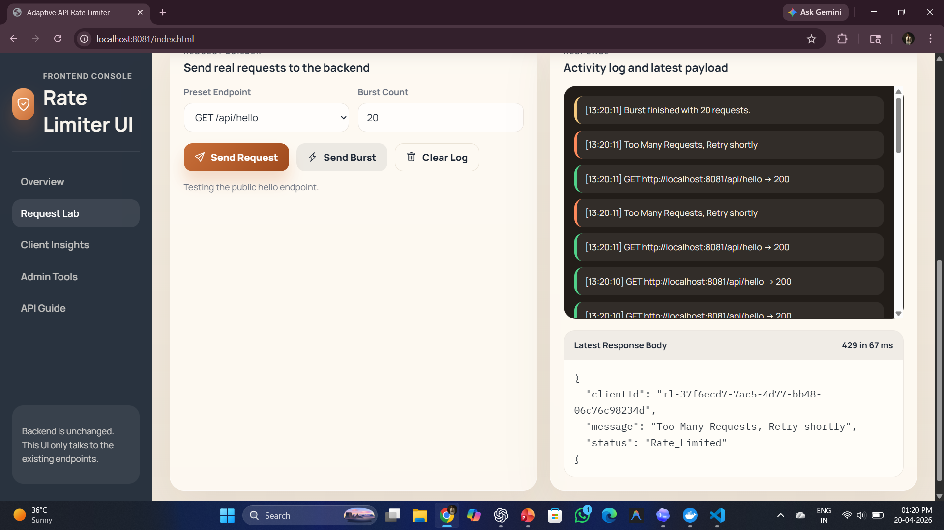

Slide 18
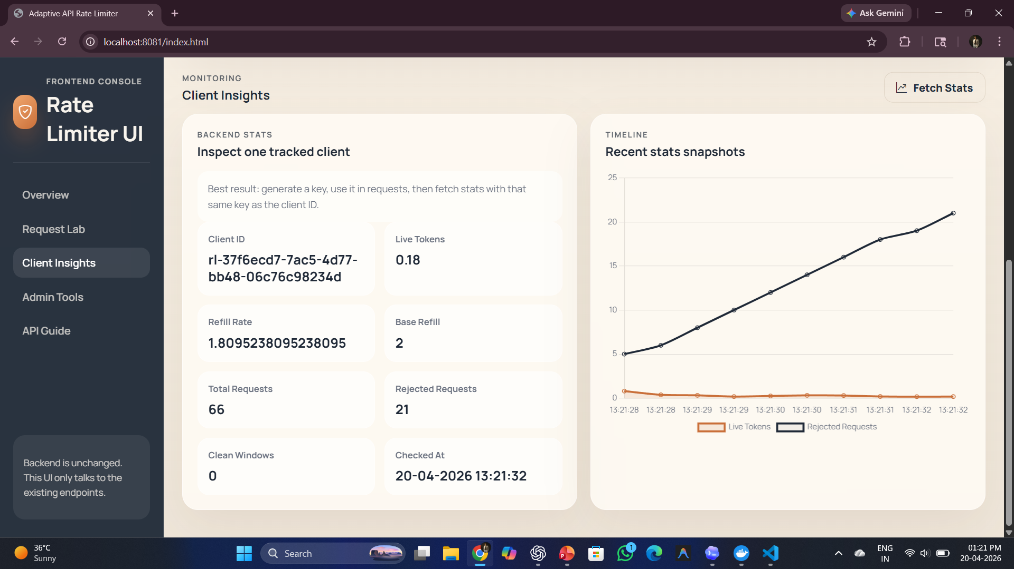

Slide 19


Slide 20
REAL-WORLD APPLICATIONS
Protects public APIs, secures microservices, mitigates DDoS attacks, and supports SaaS-based tiered rate limiting.
Customizable Rate Limiting : Bucket capacity, refill speed, and request thresholds can be configured without modifying application code.
Adaptive Tuning Controls :Observation windows, recovery conditions, and penalty mechanisms can be fine-tuned for different traffic patterns.
Infrastructure Flexibility : Supports easy configuration of Redis connections, TTL settings, and distributed deployment environments.
Scalable & Autonomous System – Enables one-click Docker deployment and automatically manages throttling, penalties, and recovery processes.

Slide 21
CONCLUSION
Successful Adaptive Security System : Developed a self-healing API protection layer by combining the Token Bucket algorithm with an Adaptive Metrics Engine.
Intelligent Traffic Control: The system distinguishes between normal traffic bursts and sustained malicious attacks using real-time behavioral analysis.
High Performance & Scalability :Achieved sub-80ms response times and high blocking efficiency through Redis-based distributed architecture.
Efficient & Lightweight Design : Lazy refill strategy and Dockerized deployment reduce resource usage and simplify integration into microservice environments.
Stronger Real-World Protection : Instead of only blocking traffic, the system dynamically shapes user behavior, rewarding legitimate users while discouraging automated attacks.

Slide 22
FUTURE ENHANCEMENT
Predictive Threat Detection – Machine Learning models can analyze traffic patterns in real time to detect anomalies and prevent attacks proactively.
Behavioral Fingerprinting – Differentiates between genuine users and automated bots by studying request timing and usage behavior .
Dynamic Parameter Optimization – Reinforcement Learning can automatically adjust refill rates, recovery speed, and penalty limits based on server conditions .
Adaptive Security Enhancement – Enables the system to strengthen protection dynamically during suspicious or high-traffic situations.

Slide 23
REFERNCES
Anderson, T., & Clark, M. (2019). Leveraging Machine Learning for Predictive Rate Limiting in Microservices. ACM Transactions on Internet Technology (TOIT), 19(1), Article 3. DOI: 10.1145/3300000
Roberts, J., & Murphy, L. (2024). Scalable and Adaptive Rate Limiting with Service Meshes. IEEE Software, 35(4), 60-67. DOI: 10.1109/MS.2018.2801234
Harris, O., & Lopez, A. (2018). Combining Circuit Breakers with Adaptive Rate Limiting for Fault Tolerance in Microservices. Proceedings of the 2018 IEEE International Conference on Resilient Systems (RES), 200-207. DOI: 10.1109/RES.2018.9001234 •
Young, B., & King, I. (2017). Token Bucket Algorithms for Efficient Rate Limiting in Microservices. Software Engineering Journal, 34(5), 678-690. DOI: 10.1016/j.sej.2017.05.003 •
Perez, L., & Martinez, C. (2019). Rate Limiting as a Service (RLaaS) for Distributed Microservices. Proceedings of the 2019 IEEE International Conference on Services Computing (SCC), 321-328. DOI: 10.1109/SCC.2019.8912345

